Slide 1
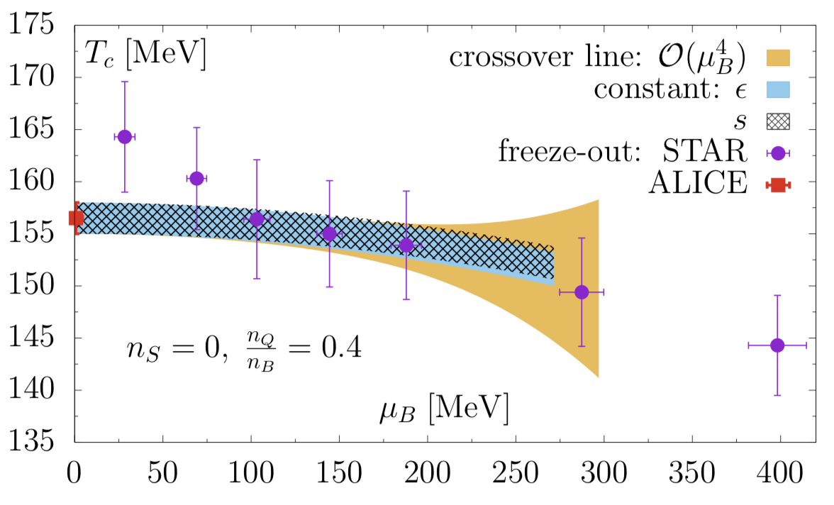


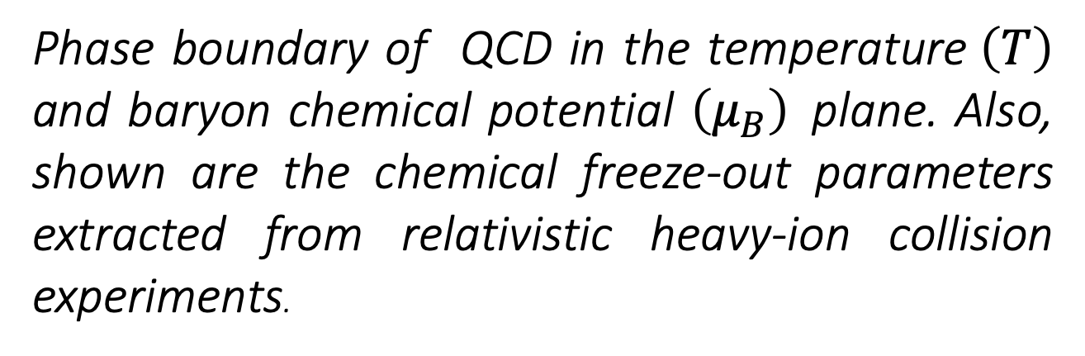
QCD phase boundary in the $T−μ_{B}$ plane
Science
The spontaneous breaking of the chiral symmetry in quantum chromodynamics (QCD) is a key ingredient for explaining the masses of hadrons that constitute almost the entire mass of our visible Universe. Lattice-regularized QCD calculations have demonstrated (near) restoration of the broken chiral symmetry in QCD at high temperature through a smooth crossover. The chiral crossover temperature of QCD marks the epoch at which massive hadrons were born during the evolution of the early Universe. Furthermore, when QCD-matter is doped with an excess of quarks over antiquarks, i.e. for non-zero baryon chemical potential, the chiral crossover in QCD might lead to a rich phase diagram. The phase structure of QCD-matter can be probed in various ongoing and upcoming relativistic heavy-ion collision experiments, such as the Beam Energy Scan (BES) at the Relativistic Heavy Ion Collider (RHIC). The phase diagram of QCD can be explored in these experiments if the so-called chemical freeze-out takes place in the proximity of the chiral crossover phase boundary.
Phase boundary of QCD in the temperature$\left(T\right)$ and baryon chemical potential $\left(μ_{B}\right)$plane. Also, shown are the chemical freeze-out parameters extracted from relativistic heavy-ion collision experiments.
Impact
We computed the pseudo-critical temperatures of QCD chiral crossovers at zero and non-zero values of baryon, strangeness, electric charge, and isospin chemical potentials. The results were obtained using lattice QCD calculations carried out with physical values of up, down and strange quark masses. For baryon chemical potential less than 300 MeV, the chemical freeze-out takes place in the vicinity of the QCD phase boundary, which coincides with the lines of constant energy density and constant entropy density.
Publication
HotQCD Collaboration: Phys. Lett. B795 (2019)

